Slide 1
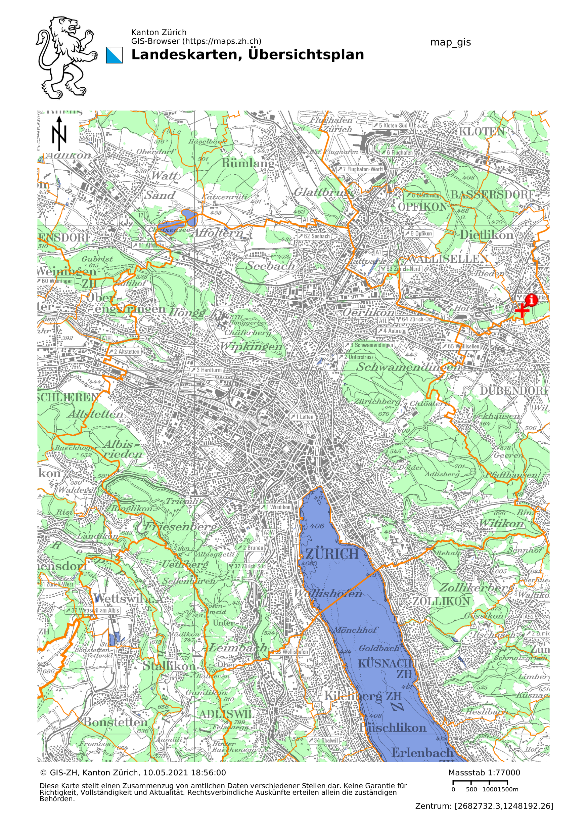
Introduction to Data Science Project Accident Analysis in Zurich David Linder, Marcelo Looser

Slide 2
Content
Introduction
Data preparation
Exploratory analysis
Results
Questions

Slide 3
Introduction
Questions that we tried to answer:
Which features in the data set are significant when accidents occur, correlations?
Can we classify certain features in dependence of a subset of other features?
Can we find the underlying probability distribution of the samples?
and what do they tell us?

Slide 4
Data preparation
The given data sets are quiet messy.
The goal is to clean up all the data sets and save them in destinct tables.
Link the data sets by certain features.
With additional merging in a separate table.

Slide 5
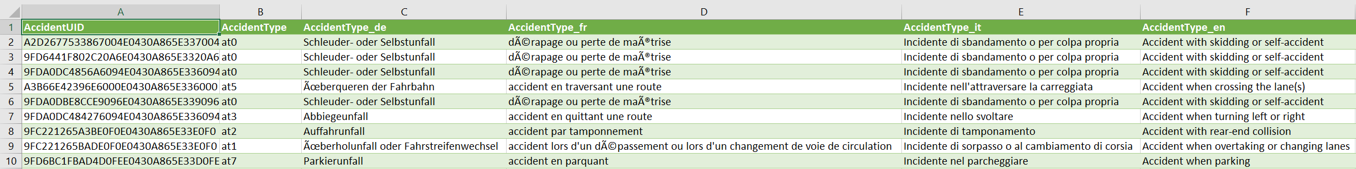
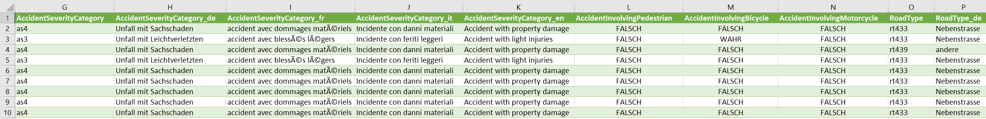
Data preparation, accidents in Zurich
Drop unimportant columns

Slide 6
Data preparation, accident data
Change strings to integer, and change false/true statements to 0/1

Slide 7
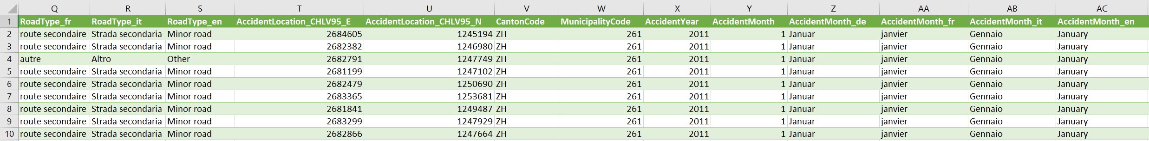
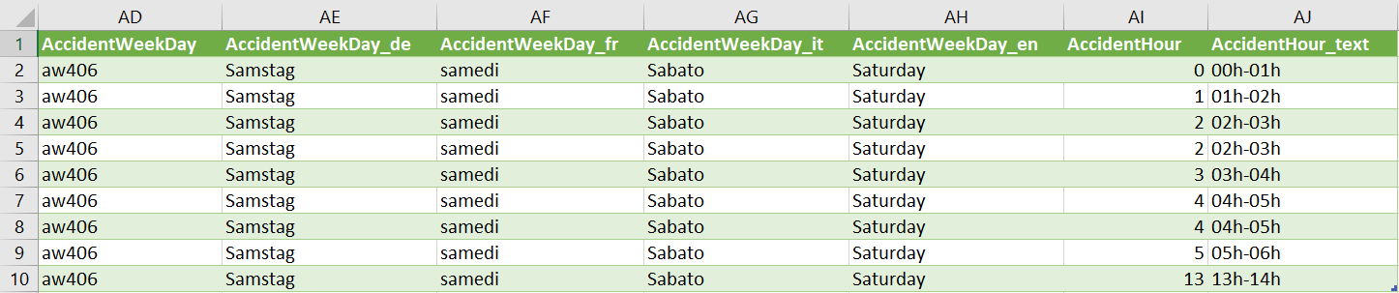
Data preparation, accident data
Merge date objects to one column called Date

Slide 8
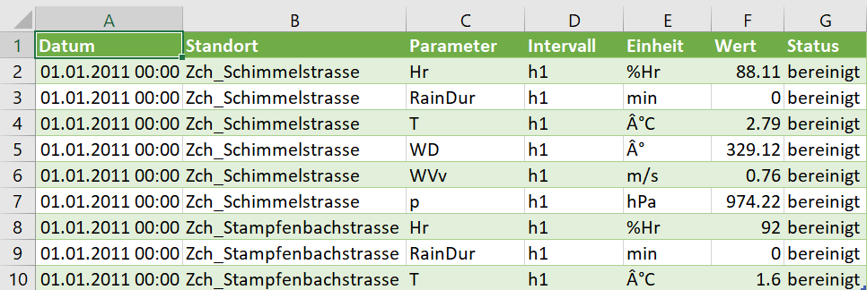
Data preparation, meteo data
Drop unimportant rows and columns
Take the average of the remaining data, with respect to n measurement locations.

Slide 9
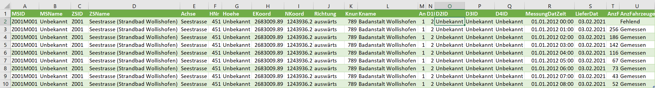
Data preparation, counts of cars on the road
Drop unimportant columns

Slide 10
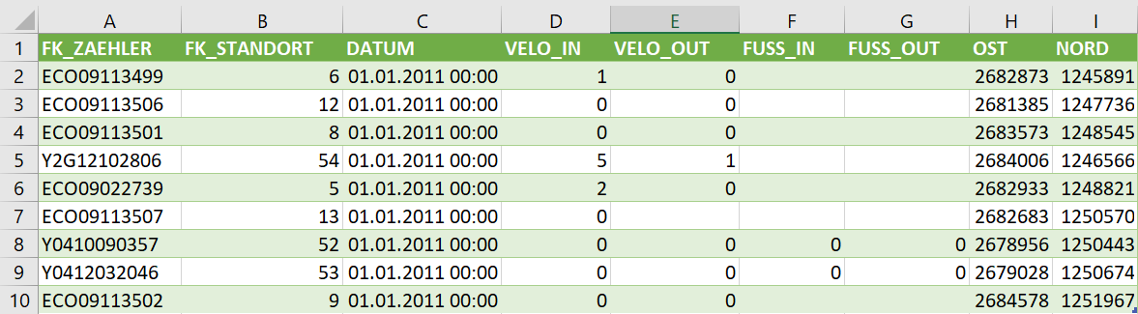
Data preparation, counts of pedestrians and bysicles on the road
Drop unimportant columns.
Add counts together on both sides of the lane to get the total.
The measurements were taken every 15 min; get the total for one hour.

Slide 11
Data preparation, merging
The average temperature and rain durations
were added to every accident according
to the date.
The count data sets were merged with
respect to the location and the date.
To do this, we located the accidents
within a radius of 200m.

Slide 12
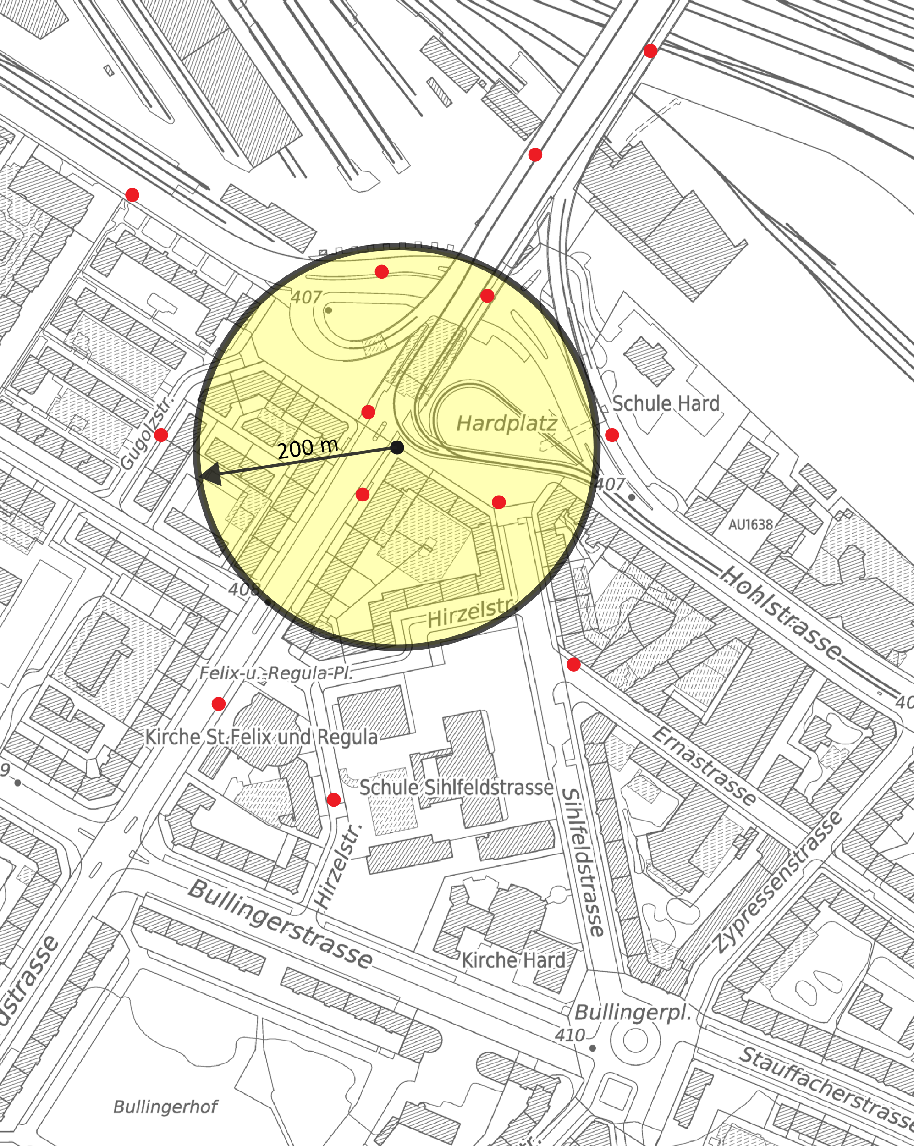
Data preparation, merging
The average temperature and rain dur-
ations were added to every accident
according to the date.
The count data sets were merged with
respect to the location and the date.
To do this, we located the accidents
within a radius of 200m.

Slide 13
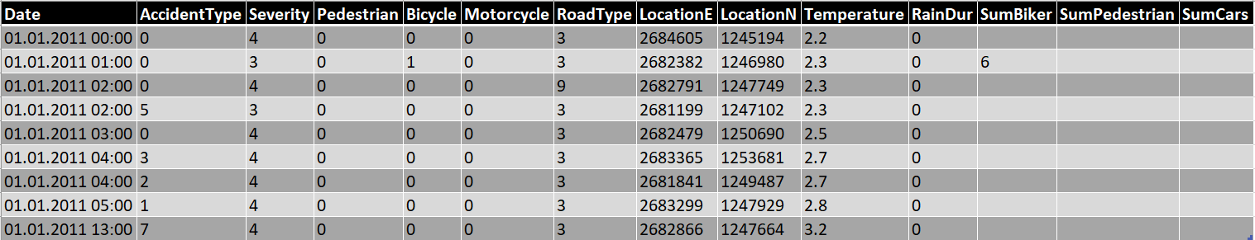
Data preparation
The merged and cleand data sets are now ready to undergo some analysis.

Slide 14
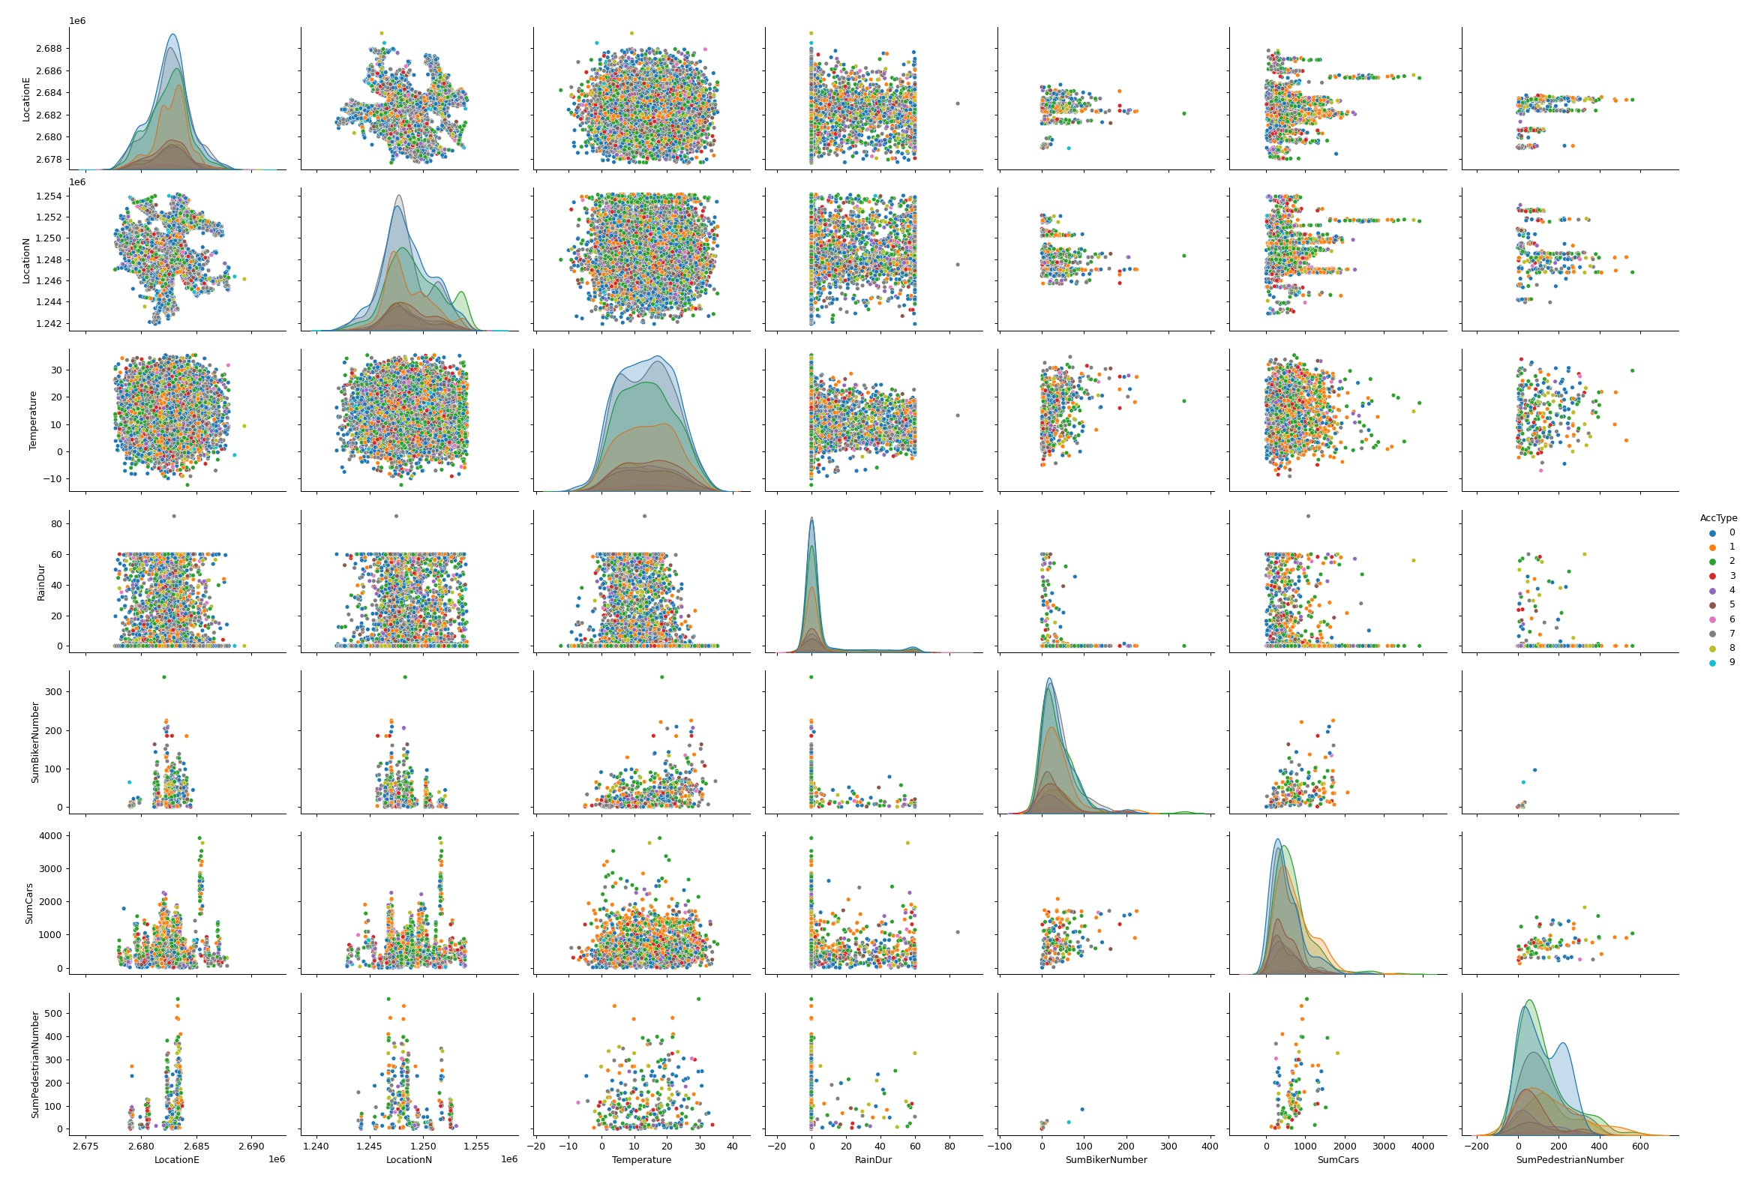
Exploratory analysis
0: Accident with skidding or self-accident
1: Accident when overtaking or changing lanes
2: Accident with rear-end collision
3: Accident when turning left or right
4: Accident when turning-into main road
5: Accident when crossing the lane(s)
6: Accident with head-on collision
7: Accident when parking
8: Accident involving pedestrian(s)
9: Accident involving animal(s)
SumPedestrian SumCar SumBicycle RainDur Temperature LocationN LocationE
LocationE LocationN Temperature RainDur SumBicycle SumCar SumPedestrian

Slide 15
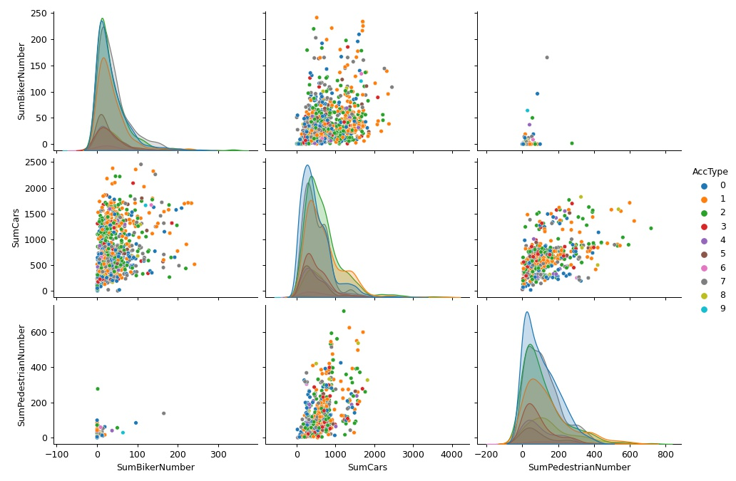
Exploratory analysis
There is no clear clustering
between the classes.
We se some trends in the
scatter plot, but not

Slide 16
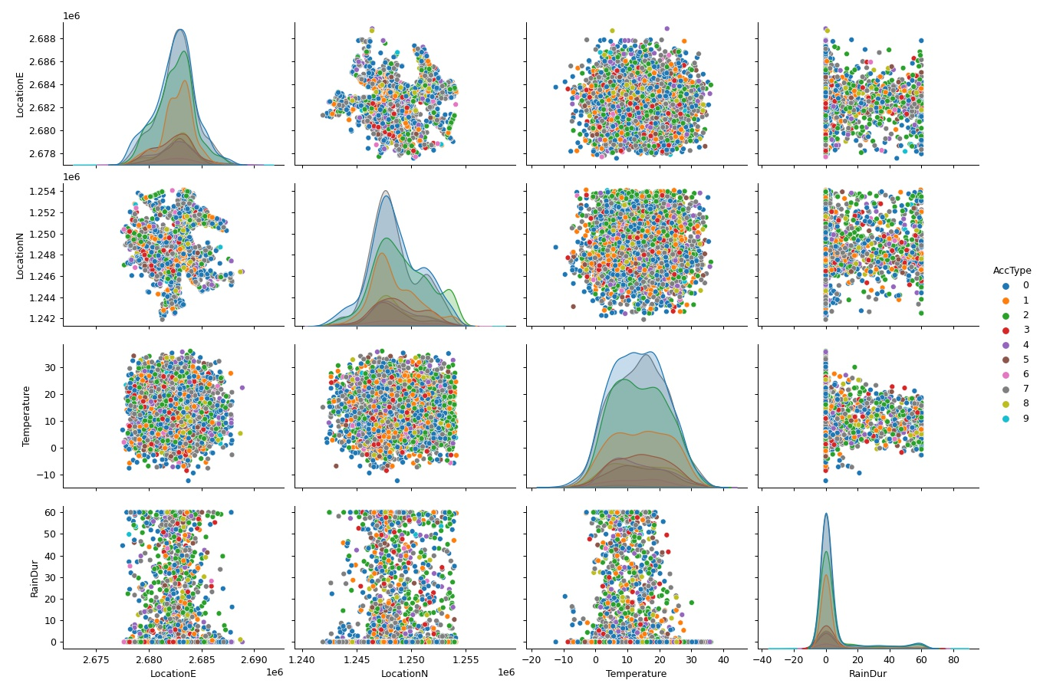
Exploratory analysis

